Slide 1
Creating an ASP.NET core web app with user data protected by authorization
GROUP 5

Slide 2
Project Overview
The Contact Manager Web Application, built on ASP.NET Core, is structured to streamline contact information management with a strong focus on user authentication and authorization. It is tailored to accommodate three distinct security groups: Registered Users, Managers, and Administrators, each assigned specific roles and permissions for enhanced security measures.

Slide 3
Team members
ANNITE GEE VARGHESE
NIJI BIJU
JOSMY ANN JOSE
DEVIKA CHENKULAM

Slide 4
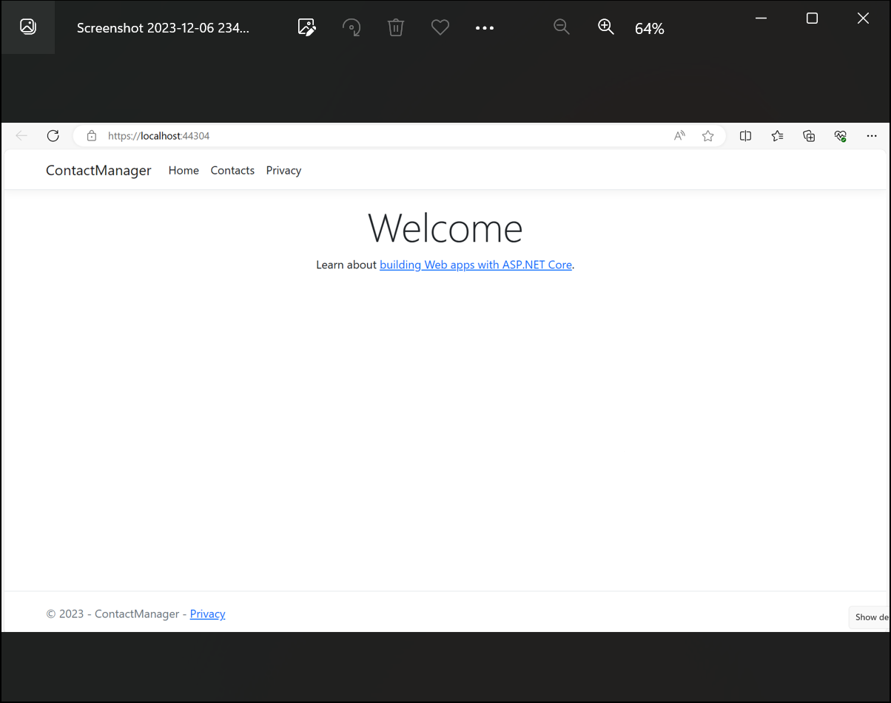
The Welcome Page serves as the initial landing point for visitors. It provides a clear call-to-action, directing users to the login page for accessing the application's information securely

Slide 5
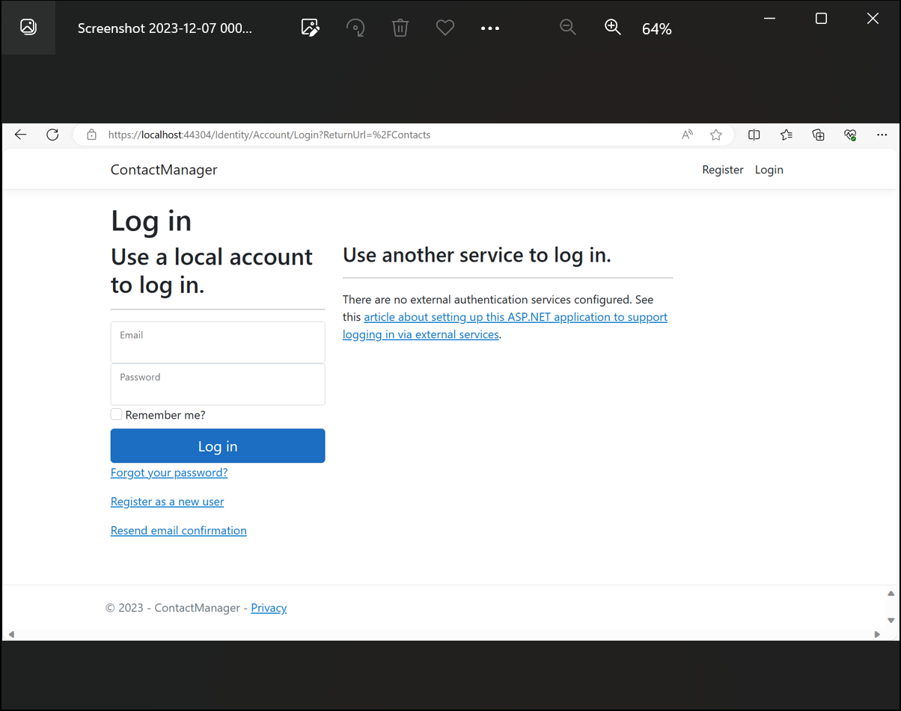
Screenshot of the Login Page, the initial point of entry for authorized users. Here, the administrator is entering their email address and password for authentication. The system ensures a secure login process to protect user credentials and maintain data integrity

Slide 6
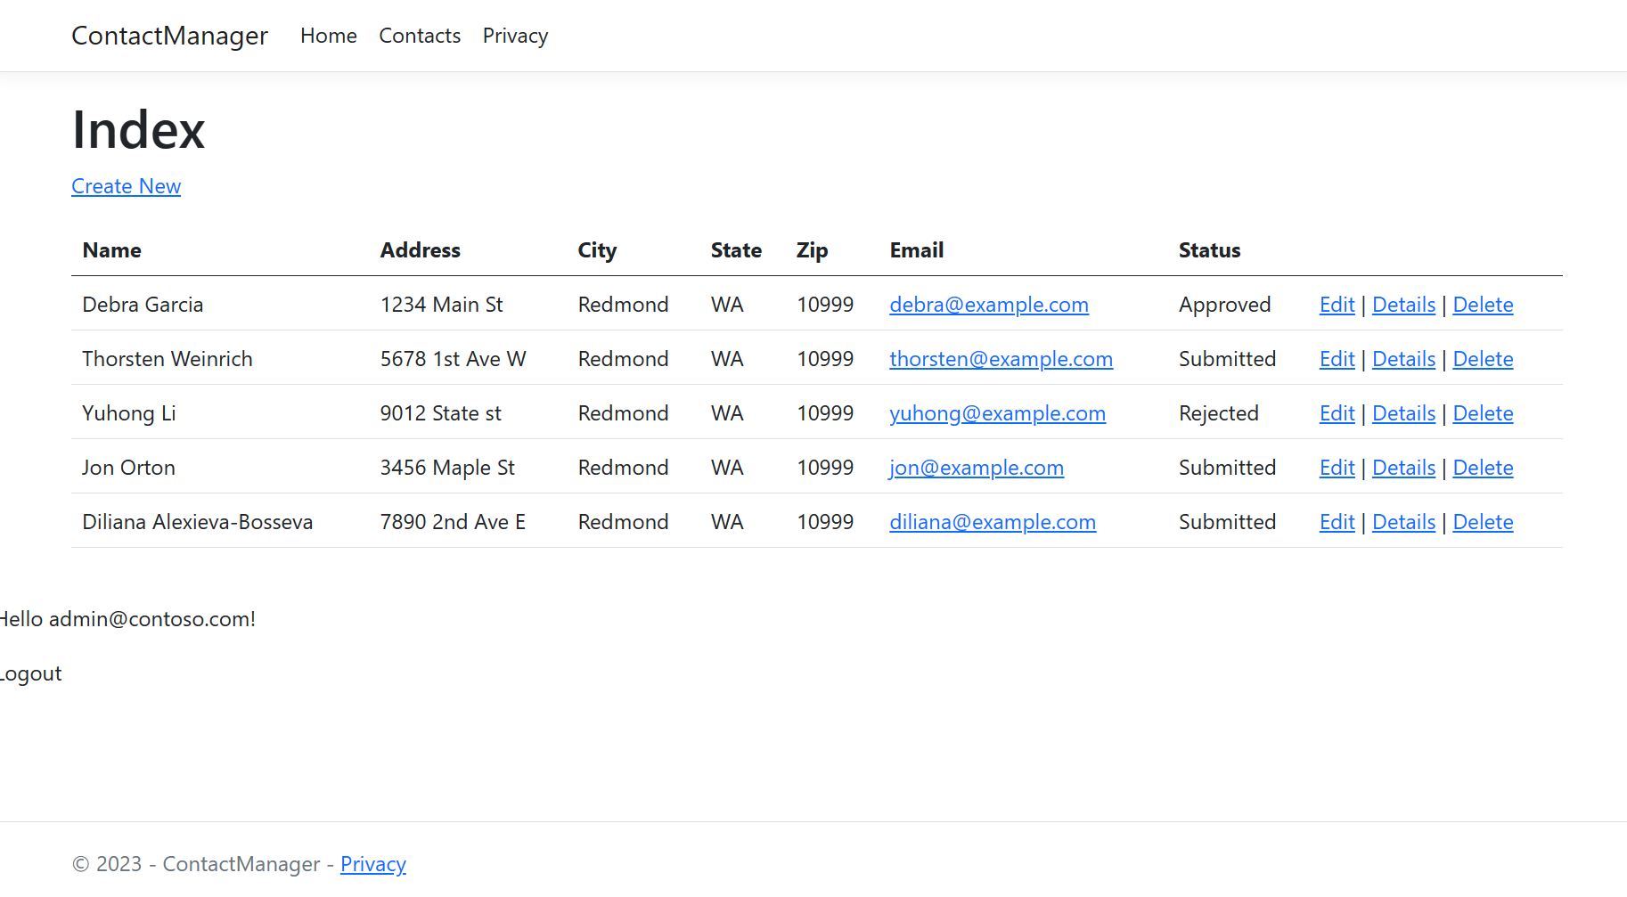
In this screenshot, the Admin Index Page is displayed, offering a comprehensive view of all members. The admin has options to edit, view details, and delete member data, empowering them with the ability to manage the user database efficiently

Slide 7
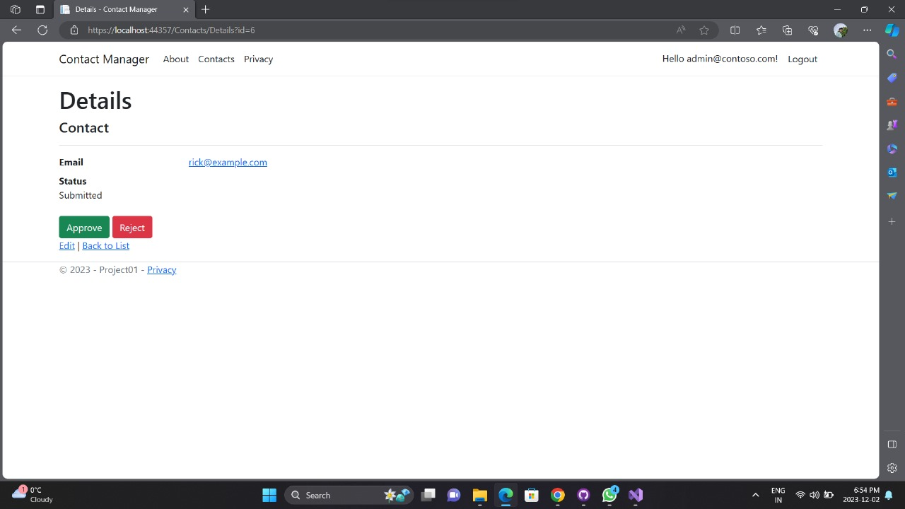
Screenshot of Detail Page for administrators, where they have the authority to either approve or reject members. This crucial functionality ensures that administrators have control over the approval workflow, maintaining data accuracy and integrity

Slide 8
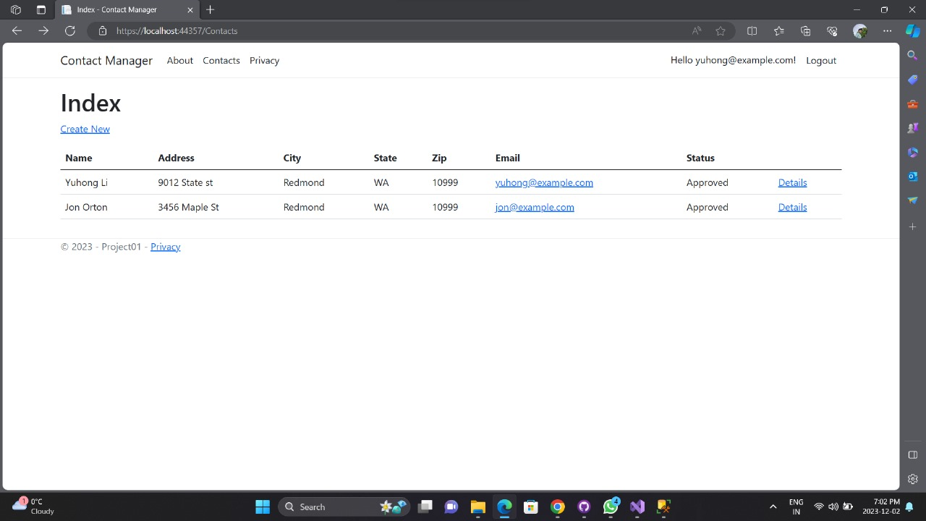
Here, the Index Page for a registered user is displayed, showcasing only approved members. This restriction ensures that registered users can view and interact with a curated list of contacts, maintaining data privacy and security

Slide 9
Key Features
User Authentication and Authorization:
The application features a robust authentication system that enables users to both register and log in securely.
Role-specific Permissions:
Registered Users are granted the ability to view all approved contacts, as well as edit and delete their contact data. Managers, in addition to having the capability to view all approved contacts, are tasked with the responsibility of approving or rejecting contact data. Administrators, possessing the highest level of access, have the authority to approve/reject, edit, and delete any contact data.
Data Security:
Data security is a top priority in the application, ensuring that only individuals with proper authorization can access sensitive contact information. Industry-standard encryption techniques are employed to securely store passwords.
Contact Listing:
Only contacts marked as approved are visible to users, while rejected contacts remain hidden.

Slide 10
Conclusion
The Contact Manager Web Application provides a safe and efficient platform for handling contact data, assuring a smooth user, manager, and administrator experience. The solution meets the privacy and security concerns of all stakeholders by meticulously integrating authentication, authorization, and role-specific functionalities. Its modular design allows for future modifications to meet changing security requirements.

Slide 11
THANK YOU…

